Slide 1
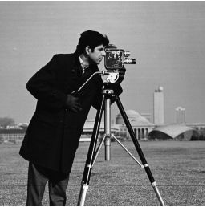
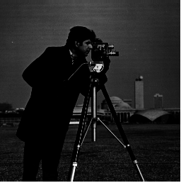
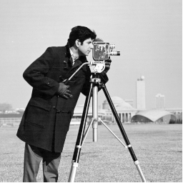
Consider the following 8-bit image:
Apply the following transformation to this image and show the histogram of the NEW image.
16 | 16 | 64 | 64
4 | 16 | 16 | 4
4 | 16 | 16 | 4
100 | 225 | 225 | 100
Question 1
s = c x r^{1/2}
Assume c= 1
Question 2
Original Image
Transformation A
Transformation B
Show the possible ‘general’ shape of the transformation functions A and B

Slide 2
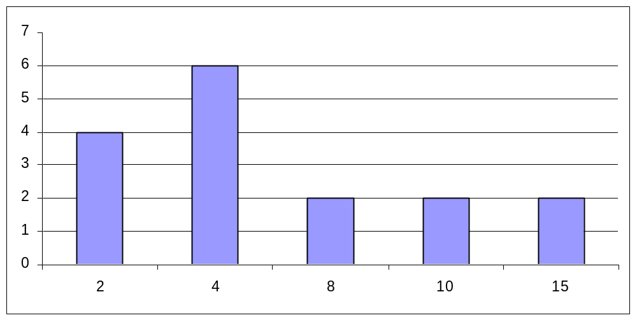
Consider the following 8-bit image:
Apply the following transformation to this image and show the histogram of the NEW image.
16 | 16 | 64 | 64
4 | 16 | 16 | 4
4 | 16 | 16 | 4
100 | 225 | 225 | 100
Question 1
s = c x r^{1/2}
Assume c= 1
Image after transformation
Histogram of new Image
4 | 4 | 8 | 8
2 | 4 | 4 | 2
2 | 4 | 4 | 2
10 | 15 | 15 | 10
Solution

Slide 3
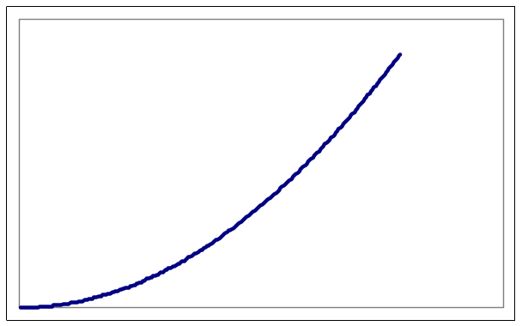
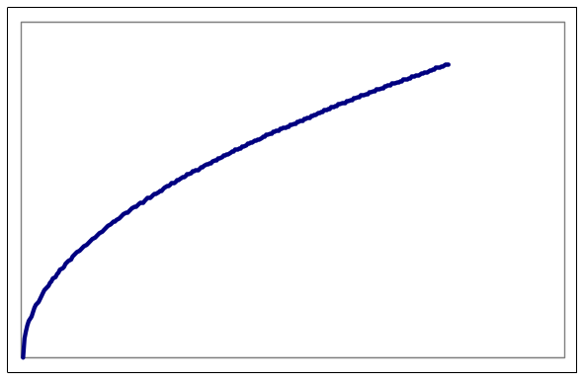
Question 2
Original Image
Transformation A
Transformation B
Show the possible ‘general’ shape of the transformation functions A and B
Transformation A
Transformation B
Solution

